Slide 1
German University in Cairo | 2025
Page
01
GO-DRIVES MOBILE APP FOR PASSENGER-VEHICLE REAL-TIME INTERACTION WITH IN-CAMPUS GOLF CAR
Presentation by
Manuella Ehab
Supervised by
Dr.Catherine Elias

Slide 2
German University in Cairo | 2025
Page
02
OVERVIEW
Introduction
Research Gap
Result
Problem Formulation
Objectives
Conclusion
Literary Review
Methodology
Fututre Recommendations

Slide 3
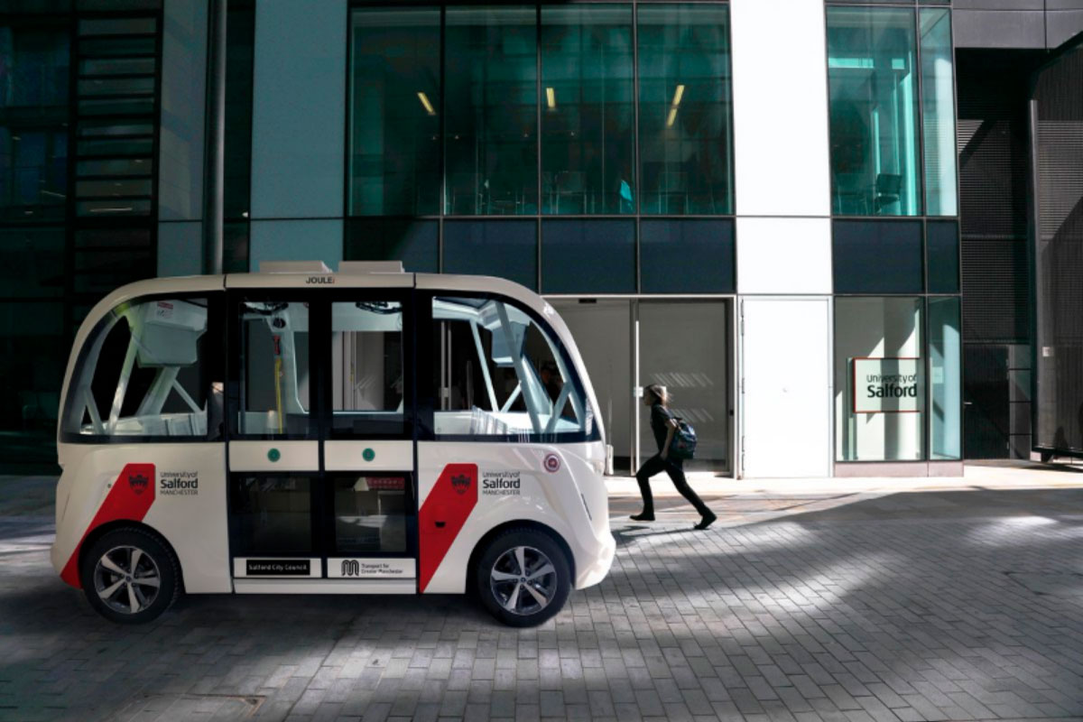
German University in Cairo | 2025
Page
03
INTRODUCTION
Embracing the Future of Transportation: Autonomous Vehicles on Our Campus
What are autonomous vehicles (AVs)?
Why AVs make sense on campus?

Slide 4
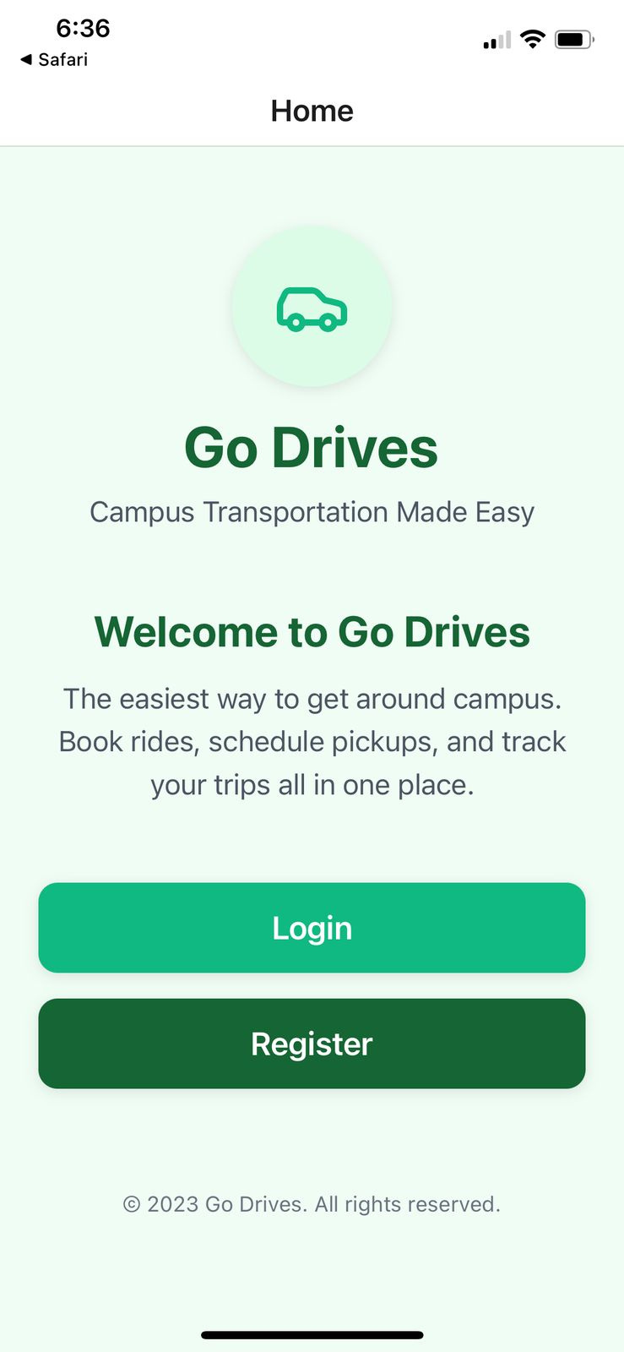
German University in Cairo | 2025
Page
04
INTRODUCING GO-DRIVES
GoDrives helps make campus transportation simple and efficient
Designed to help with the passenger-vehicle real-time interaction.

Slide 5
German University in Cairo | 2025
Page
05
WHAT IS THE PROBLEM?
Problem 1
Problem 2
Existing ride-hailing apps (Uber, Kareem) don’t support campus AV environments.
AV tracking was researched but never implemented as a mobile solution.

Slide 6
German University in Cairo | 2025
Page
06
LITERARY REVIEW
Paper | Focus
Real-Time Campus University Bus Tracking Mobile Application | GPS Bus Tracker
Smart Transportation System using IOT | IoT + ZigBee
Integrating Vehicle Positioning and Path Tracking Practices for an Autonomous Vehicle Prototype in Campus Environment | AV Path Planning and Position Accuracy
Most research emphasized sensor fusion and path planning, not user interaction.
Almost all works lack real-time, mobile-based interaction between users and autonomous vehicles, especially in campus environments.

Slide 7
German University in Cairo | 2025
Page
07
LITERARY REVIEW
What previous researchers used and why:
App Development: Blynk, Flutter, and MIT App Inventor for quick mobile interface creation.
Backend & Database: Firebase for real-time syncing and easy integration.
Map API: Google Maps API.

Slide 8
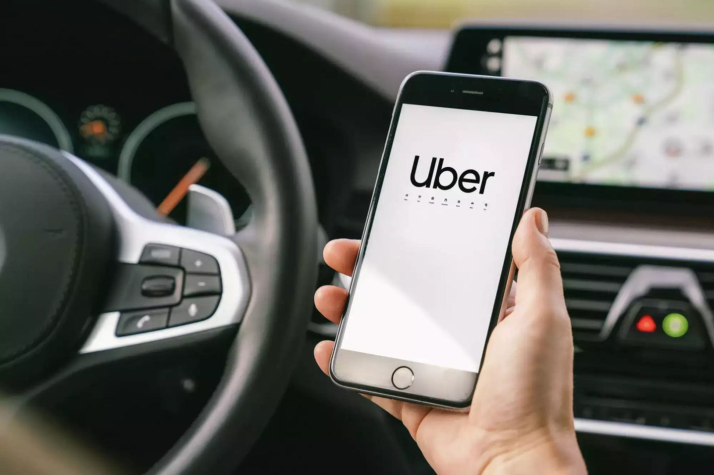
German University in Cairo | 2025
Page
08
RESEARCH GAP
Existing ride apps (Uber, Kareem) are not designed for AVs or campus use.
AV-related apps mostly focus on the vehicle itself, not on the user experience.
Limited research on mobile apps connecting users to in-campus AV transport.

Slide 9
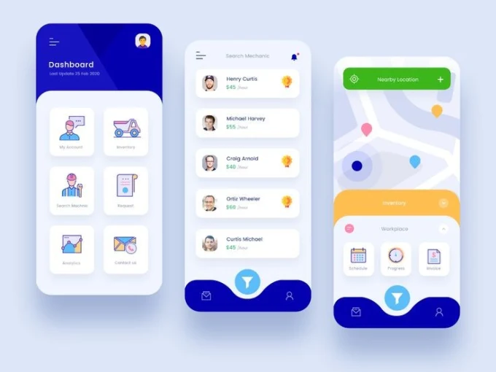
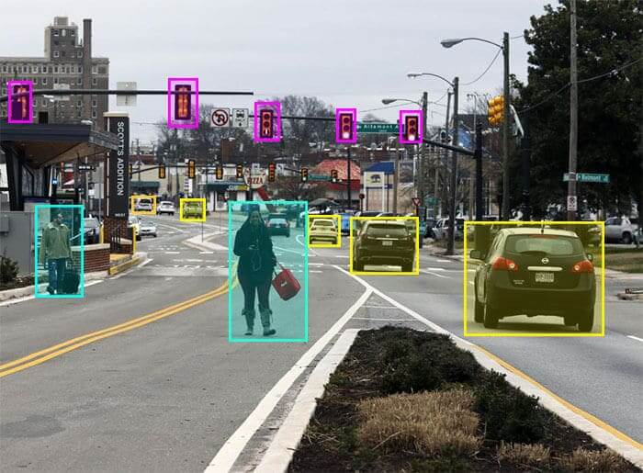
German University in Cairo | 2025
Page
09
OBJECTIVES
Passenger User Interface
Real-time AV camera
Design an intuitive mobile interface for passengers to interact with the AV and track its data.
Display live camera feeds with bounding boxes on detected pedestrains,vehicles and scene objects.

Slide 10

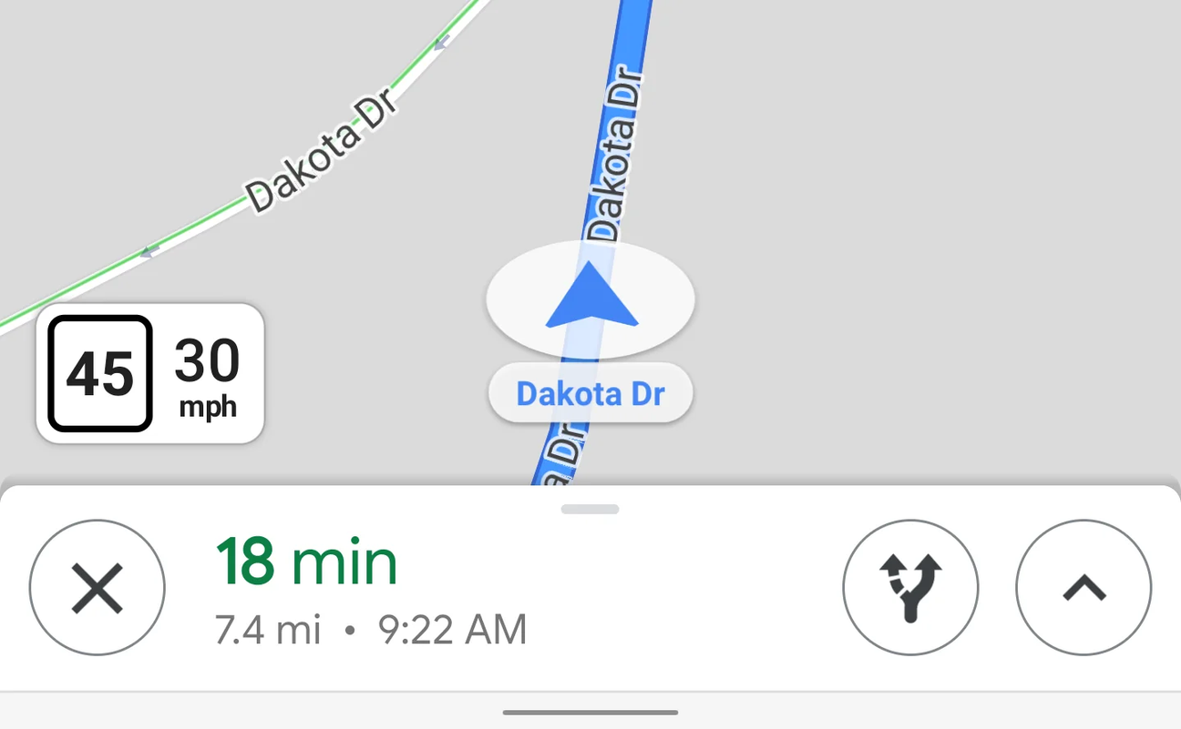
German University in Cairo | 2025
Page
10
OBJECTIVES
Notification system for critical events
Ride info: location, speed, ETA
Alert users about important events during the ride.
eg: pedestrain crosssing the street
Provide passengers with essential journey information

Slide 11
German University in Cairo | 2025
Page
11
METHODOLOGY
Planning
WEEK 1
Collected information to understand the project and what users need.
Researched similar apps and AV systems to get ideas.
Started planning what basic features are needed
Designing
Development
Testing

Slide 12
German University in Cairo | 2025
Page
12
METHODOLOGY
Planning
WEEK 2
Made rough designs for the app screens for both passengers and pedestrains.
Picked the most important features to include.
Created a simple plan showing how the app connects with the campus AV system.
Designing
Development
Testing

Slide 13
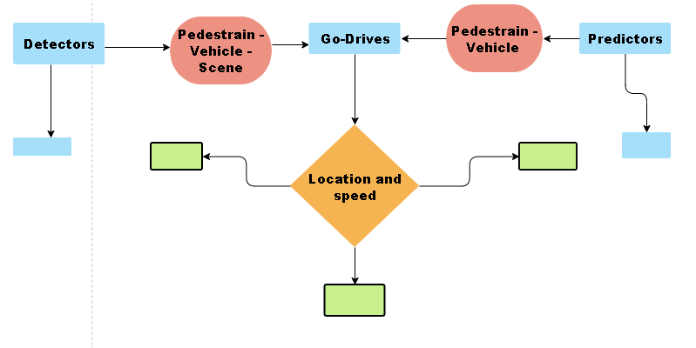
German University in Cairo | 2025
Page
13
METHODOLOGY
Planning
Designing
Development
Testing

Slide 14
German University in Cairo | 2025
Page
14
METHODOLOGY
Planning
WEEK 3-5
Used React Native with Expo to build the app.
Built the backend with Node.js and Express.
Used MongoDB to store user and vehicle data.
Connected to ROS2 for sending and receiving data from the golf car:
Published the car's location and speed.
Listened to passenger, vehicle, and object location
Designing
Development
Testing

Slide 15
German University in Cairo | 2025
Page
15
METHODOLOGY
Planning
WEEK 6
Tested the app using Expo Go.
Checked how accurate the location and speed tracking is.
Tested and deployed backend
Made sure the ROS nodes send and receive data correctly.
Designing
Development
Testing

Slide 16
German University in Cairo | 2025
Page
16
FURTHER TESTING
Route Changing
Location Accuracy Test
Notify passenger when rote changes and clearly show new drawn route on screen.
Move around campus and check how accurately the app shows the position on OpenStreetMap.
Network Disconnection Test
Speed Update Delay Test
Turning off Wifi and seeing how the app will react
Check if there’s a noticeable lag between actual vehicle movement and app display

Slide 17
German University in Cairo | 2025
Page
17
RESULTS
Successfully built a working mobile app for in-campus-AV and passenger real-time interaction.
Real-time vehicle location and speed are displayed accurately using device GPS.
ROS2 integration successfully sends and receives data from the AV system.
Custom backend and authentication system built.

Slide 18
German University in Cairo | 2025
Page
18
CONCLUSION
This project successfully built the main parts of GO-DRiVeS — a mobile app that connects people with self-driving golf cars on campus. It includes passenger and pedestrain interfaces, live data sharing, and key user features. This is an important step in making AVs more useful for everyday campus travel. With more testing and new features, GO-DRiVeS can become a helpful and reliable tool for smarter campus transportation.

Slide 19
German University in Cairo | 2025
Page
19
FUTURE RECOMMENDATIONS
Improve UI
Implement larger buttons and voice feedback for visually impaired users.
Offline Mode + Auto-Sync
Let the app function temporarily offline and sync ride history/data once connection is restored — helpful in dead zones or areas with bad connection.

Slide 20
German University in Cairo | 2025
Page
20
THANK YOU
FOR YOUR ATTENTION

